Slide 1
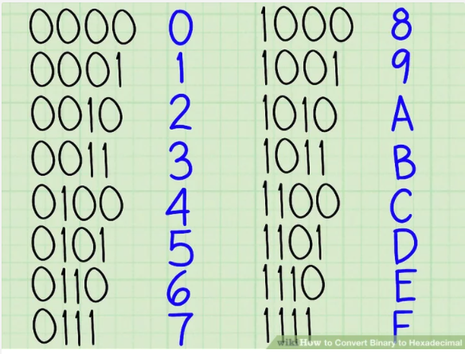
Decimal - Hexadecimal - Binary
Decimal
0
1
2
3
4
5
6
7
8
9
10
11
12
13
14
15

Slide 2



Assembler Training
Session 3

Slide 3

1
Addressing , Load and Store Instructions
Reach out to Ghosh, Ashmita ashmita.ghosh@mphasis.com / Schmeisser, Christopher christopher.s@mphasis.com

Slide 4
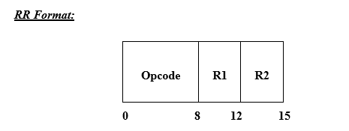
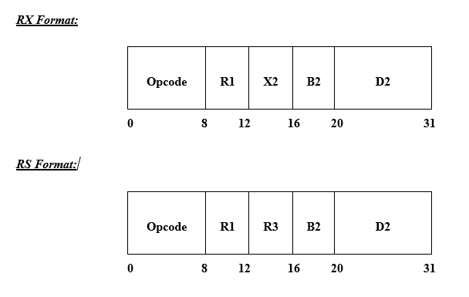
Instruction Formats
LR R1,R2
L R1,D2(x2,b2)
L R1,40(R2,R3)
LM R1,R3,D2(B2)
LM R1,R3,40(R5)

Slide 5
Load Vs Store
Load
Loading Data from
Storage
into
Registers
Store
Moving Data from
Registers
to
Storage

Slide 6
Load and Store Instructions
Load Address – LA
Load Register – LR
Load Full word – L
Load Halfword - LH
Load Multiple – LM
Store Full word – ST
Store Halfword –STH
Store Multiple -STM
Insert Character - IC
Insert Character under Mask
– ICM
Store Character -STC
Store Character under Mask
– STCM

Slide 7
Load and Store Instructions
Load Address – LA
Load Register – LR
Load Full word - L
Store Full word – ST
Load Halfword - LH
Store Halfword –STH
Load Multiple – LM
Store Multiple -STM
Insert Character - IC
Store Character –STC
Insert Character under Mask
– ICM
Store Character under Mask
– STCM

Slide 8
Generic Information
R → Register (R0-R15)
D → Displacement value (usually specified as a decimal value)
X →Index register (R0-R15)
Example,
Base register R2 - 00 00 10 00
Index register R3 - 00 00 30 00
Displacement/offset - 00 00 04 00
Effective address is (R2)+(X3)+Disp =1000+3000+400
=00 00 44 00

Slide 9

Load Address Instruction
Places the effective address of the Operand 2 into the register specified Operand 1 . RX Type Op code = 41
LA R1,D2(X2,B2)
→Condition Code – Unchanged
→Do not use R0 as base and index register
LA R2,32(R4,R8) or LA R2,LABEL1
Address 00000128
LABEL 1
Before:
R2
0 0 | 0 0 | 0 0 | 1 0
0 0 | 0 0 | 0 0 | 0 C
R2
LABEL 1
After:
0 0 | 0 0 | 0 1 | 2 8
0 0 | 0 0 | 0 0 | 0 C

Slide 10
Load Address Instruction cont…
The load address instruction also provides a good way to load a register with a constant.
LA R2,4
Displacement = 4 => Effective address = Base + Index + Displacement = 4
LA R2,1(R0,R2) or LA R2,1(R2)
R2 = 0A000102 Effective address = 0A000102 +0 + 1 = 0A000103 – Load to R2

Slide 11

Load Register Instruction
Replace the contents of the register specified in operand 1with the contents of the register specified in operand 2. Operand 2’s contents remain unchanged. RR Type Op code = 18
LR R1,R2
→Condition Code – Unchanged
LR R2,R3
Before:
R2
R3
0 0 | 0 0 | 0 0 | 1 0
0 0 | 0 0 | 0 0 | 2 3
R2
R3
After:
0 0 | 0 0 | 0 0 | 2 3
0 0 | 0 0 | 0 0 | 2 3

Slide 12

Load Instruction
Copies fullword (4 bytes) from storage to a register. The storage location is unchanged. RX Type Op code = 58
L R1,D2(X2,B2)
→Condition Code – Unchanged
L R2,32(R4,R8) or L R2,LABEL1
Before:
R2
LABEL 1
0 0 | 0 F | 0 B | 1 E
0 0 | 0 0 | 0 0 | 0 C
R2
LABEL 1
After:
0 0 | 0 0 | 0 0 | 0 C
0 0 | 0 0 | 0 0 | 0 C

Slide 13

Load Halfword Instruction
Copies halfword (2 storage bytes) to the 2 low order bytes of a register. The high order bit of Operand 2 is propagated in the 2 high order bytes of the register. The storage location is unchanged. RX Type Op code = 48
LH R1,D2(X2,B2)
→Condition Code – Unchanged
LH R2,LABEL1
Before:
R2
LABEL 1
0 0 | 0 F | 0 B | 1 E
2 A | 9 8 | 1 E | C D
R2
LABEL 1
After:
0 0 | 0 0 | 2 A | 9 8
2 A | 9 8 | 1 E | C D
0010 1010 .....
high order bit of Opr2 is propagated in high order halfword

Slide 14
Load Halfword Instruction
LH R2,LABEL1
Before:
R2
LABEL 1
0 0 | 0 F | 0 B | 1 E
A A | 9 8 | 1 E | C D
R2
LABEL 1
After:
F F | F F | A A | 9 8
A A | 9 8 | 1 E | C D
1010 1010 .....
high order bit of Opr2 is propagated in high order halfword

Slide 15

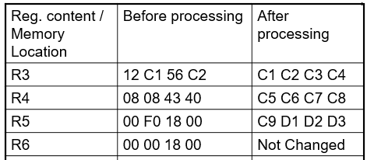
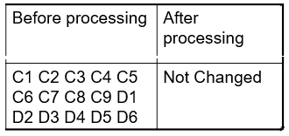
Load Multiple Instruction
Load several consecutively numbered registers from consecutive fullwords of storage.
RS Type Op code = 98
LM R1,R2,D3(B3)
→ Condition Code – Not Changed
LM R3,R5,DATA
DATA

Slide 16

Store Instruction
Copies fullword (4 bytes) from a register to storage. The contents of the register are unchanged.
RX Type Op code = 50
ST R1,D2(X2,B2)
→Condition Code – Unchanged
ST R2,LABEL1
Before:
R2
LABEL 1
0 0 | 0 F | 0 B | 1 E
0 0 | 0 0 | 0 0 | 0 C
R2
LABEL 1
After:
0 0 | 0 F | 0 B | 1 E
0 0 | 0 F | 0 B | 1 E

Slide 17

Store Half word Instruction
Copies a register’s 2 low order bytes to a halfword storage area. The contents of the register remain unchanged.
RX Type Op code = 40
STH R1,D2(X2,B2)
→Condition Code – Unchanged
STH R2,LABEL1
Before:
R2
LABEL 1
0 0 | 0 F | 0 B | 1 E
0 E | C D | 2 A | 9 8
R2
LABEL 1
After:
0 0 | 0 F | 0 B | 1 E
0 B | 1 E | 2 A | 9 8

Slide 18

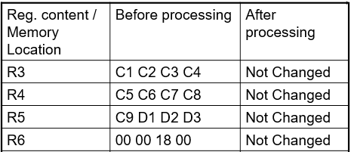
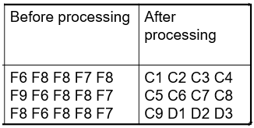
Store multiple Instruction
Copies the contents of consecutively numbered registers to consecutive fullwords of storage. RS Type Op code = 90
STM R1,R3,D2(B2)
→Condition Code – Not Changed
90
STM R3,R5,DATA
DATA

Slide 19
Summarizing -Load and Store Instructions
Load Address – LA - RX
Load Register – LR - RR
Load Full word – L - RX
Load Halfword – LH - RX
Load Multiple – LM - RR
Store Full word – ST - RX
Store Halfword –STH - RX
Store Multiple –STM- RS
Insert Character - IC
Insert Character under Mask
– ICM
Store Character -STC
Store Character under Mask
– STCM

Slide 20

Insert Character Instruction
Inserts a storage byte into a register’s low-order byte. The register’s high order byte and the source data remain unchanged. RX Type Op code = 43
IC R1,D2(X2,B2)
→Condition Code – Unchanged
IC R2,LABEL1
Before:
R2
LABEL 1
0 E | F 2 | 0 0 | 1 0
C 1 | C 2 | C 3 | C 4
R2
LABEL 1
After:
0 E | F 2 | 0 0 | C 1
C 1 | C 2 | C 3 | C 4

Slide 21

Insert Character Mask Instruction
Inserts the contents of the left most 1 to 4 bytes of a storage area into selected bytes of a register. The storage location is unchanged. The bits of the mask correspond one-to-one with the bytes of the register. RS Type Op code = BF
ICM R1,M,D3(B3)
→Condition Code –
0 – all inserted bytes are 0.
1 - if leftmost bit of inserted bytes is 1.
2 – If the inserted bytes are not 0, but the
leftmost bit is 0
ICM R2,B'1010',LABEL1
1 2 3 4
MASK (bits) | 1 | 0 | 1 | 0
R2
R2 (HEX) | F 1 | C 2 | F 2 | C 4
Condition code would be set to 1 since the leftmost bit of the inserted bytes (F1 & F2) is 1.
LABEL1 (HEX) | F 1 | F 2 | F 3 | F 4

Slide 22

Store Character Instruction
Copy’s a register’s low-order byte to a storage byte. The register’s high order byte remains unchanged.
RX Type Op code = 42
STC R1,D2(X2,B2)
→Condition Code – Unchanged
STC R2,LABEL1
Before:
R2
LABEL 1
0 E | F 2 | 0 0 | 1 0
C 1 | C 2 | C 3 | C 4
R2
LABEL 1
After:
0 E | F 2 | 0 0 | 1 0
1 0 | C 2 | C 3 | C 4

Slide 23

Store Character Mask Instruction
Stores the contents of selected bytes of a register into the left most 1 to 4 bytes of a storage area. The bits of the mask correspond one-to-one with the bytes of the register. RS Type Op code = BE
STCM R1,M,D3(B3)
→Condition Code – Not Changed
STCM R2,B'1010',LABEL1
1 2 3 4
MASK (bits) | 1 | 0 | 1 | 0
R2
R2 (HEX) | C 1 | C 2 | C 3 | C 4
LABEL1 (HEX) | C 1 | C 3 | F 3 | F 4

Slide 24
About Mphasis
Mphasis (BSE: 526299; NSE: MPHASIS) applies next-generation technology to help enterprises transform businesses globally. Customer centricity is foundational to Mphasis and is reflected in the Mphasis’ Front2Back™ Transformation approach. Front2Back™ uses the exponential power of cloud and cognitive to provide hyper-personalized (C=X2C² _{TM}=1) digital experience to clients and their end customers. Mphasis’ Service Transformation approach helps ‘shrink the core’ through the application of digital technologies across legacy environments within an enterprise, enabling businesses to stay ahead in a changing world. Mphasis’ core reference architectures and tools, speed and innovation with domain expertise and specialization are key to building strong relationships with marquee clients. Click here to know

